Slide 1
Scientific Theory in Informatics
Computation: Algorithmic Strategies
Richard Senington
Richard.james.Senington@his.se
University of Skövde

Slide 2
Review
Automata give us models of computation
Complexity theory tells us how to measure and compare different bits of code
Algorithms run on a model of computation and can be compared through complexity theory

Slide 3
Algorithmic Strategies
Algorithms: Recipes for problem solving
Brute force
Greedy algorithms
Recursion
Divide-and-conquer
Dynamic programming
State space search
Backtracking

Slide 4
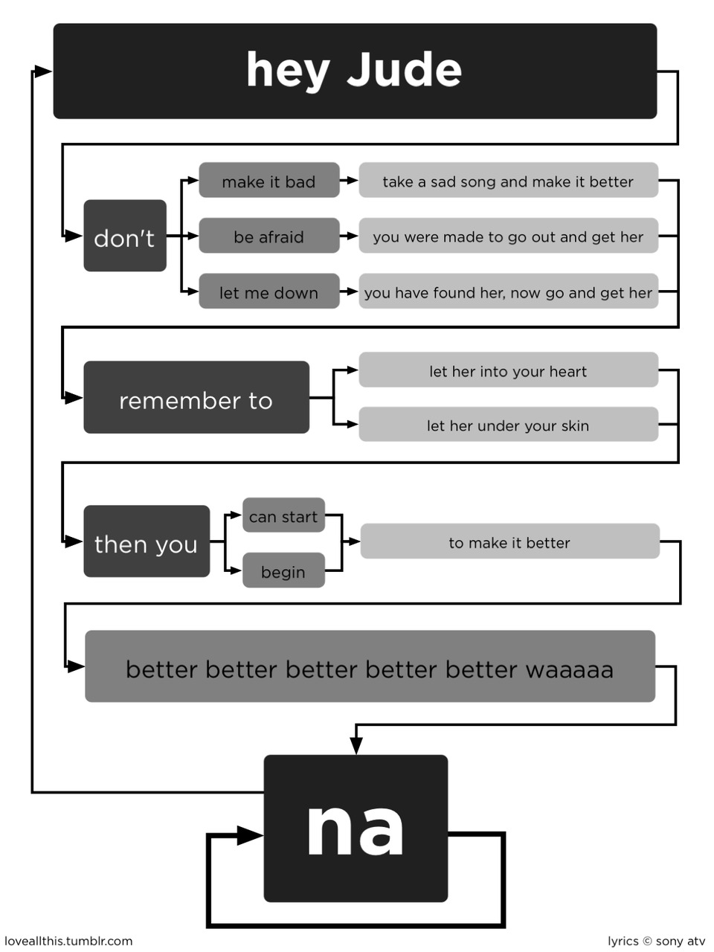
What is an Algorithm?
Abu Jafar Mohammed ibn Musa al Khowarizimi (circa 825):
“All complex problems of science must be and can be solved by means of five simple steps.”
Intuitively: A recipe or step-by-step instructions:
A method for solving a problem or a class of problems
Formal definition:
A finite sequence of instructions, each of which has a clear meaning and can be performed with a finite amount of effort in a finite length of time
Notes:
al-khowarizmi (algorithm) “from the city of Khowarazm” (the present city of Khiva in Uzbekistan).
The Al-Khwarizmi principle states that all complex problems of science must be and can be solved by means of five simple steps.

Slide 5
Algorithm Design Paradigms
General approaches to the construction of correct and efficient solutions to problems
The study of such approaches is of interest because:
They provide templates (or patterns) suited to solving a broad range of diverse problems
They can be translated into the control and data structures provided by any high-level programming language
The temporal and spatial requirements of the algorithms can be precisely and formally analyzed
Although more than one technique may be applicable to a specific problem, it is often the case that an algorithm constructed by one approach is clearly superior to equivalent solutions built using alternative techniques

Slide 6
Strategies

Slide 7
Brute Force
Brute force is a straightforward approach
solve a problem based on the problem formulation and the concepts involved directly – in TSP, try every route
Perhaps the easiest approach to apply and is useful for solving small-size instances of a problem
May result in naïve solutions with poor performance
Some examples of brute force algorithms are:
Computing a^{n} (a > 0, n a non-negative integer) by multiplying a ⋅ a ⋅ ... ⋅ a
Computing n!
Selection sort, Bubble sort
Sequential search

Slide 8
Greedy Algorithms
“Take what you can get now” strategy
The solution is constructed bit by bit
each step expands a partially constructed solution
each choice must be locally optimal – this is the central point of this technique
That is, the best choice you can see right now
Examples of problems that can be solved using a greedy algorithm:
Finding the minimal spanning tree of a graph
Finding the shortest distance in a graph
The Knapsack problem
The coin exchange problem
Using Huffman trees for optimal encoding of information

Slide 9
Divide-and-Conquer
Given an instance of the problem,
split this into several smaller sub-instances,
independently solve each of the sub-instances and then
combine the sub-instance solutions
so as to yield a solution for the original instance
With the D&Q method, the size of the problem instance is reduced by a factor (e.g. half the input size)
Examples of D&Q algorithms:
Computing a^{n} (a > 0, n a nonnegative integer) by recursion
Mergesort algorithm
Quicksort algorithm

Slide 10
Dynamic programming
One disadvantage of using D&Q is that the process of recursively solving separate sub-instances can result in the same computations being performed repeatedly
Dynamic programming is a bottom-up technique in which
the smallest sub-instances are explicitly solved first
the results of these used to construct solutions to progressively larger problem instances
these partial results are usually stored in a table to enable fast lookup later, and avoid recalculating shared results
Examples of dynamic programming algorithms:
Fibonacci numbers computed by iteration
Warshall’s algorithm for finding the shortest path in a graph implemented by iteration

Slide 11
Backtracking
Backtracking is a generate-and-test method used for state space search problems
Based on the construction of a state space tree,
whose nodes represent states,
the root represents the initial state,
one or more leaves are goal states and
each edge represents the application of an operator:
The solution is found by expanding the tree until a goal state is found
Examples of problems that can be solved using backtracking:
Puzzles (e.g., eight queens puzzle, crosswords, Sudoku)
Combinatorial optimization problems (e.g., parsing and layout problems)
Logic programming languages such as Icon, Planner and Prolog, which use backtracking internally to generate answers

Slide 12
Style

Slide 13
Procedural
The normal way to think about solving problems
Typically you have a state and an iteration until some sort of termination
Def greedy(problem):
solution=createInitialSolution(problem)
while not solves(solution,problem):
change(solution)
return solution

Slide 14
Solving Problems Recursively
How to define a problem in terms of smaller instances of the same problem?
How to reduce the size of a problem?
For which instances of the problem are solutions known (which instances are trivial)?
How to make sure that we reach trivial instances?
The Fibonacci sequence:
0, 1, 1, 2, 3, 5, 8, 13, 21, ...
Fib₀ = 0
Fib₁ = 1
Fib_{i} = Fib_{i−1} + Fib_{i−2}
long fib(int n) {
if (n <= 1)
return n;
else
return fib(n−1) + fib(n−2);
}

Slide 15
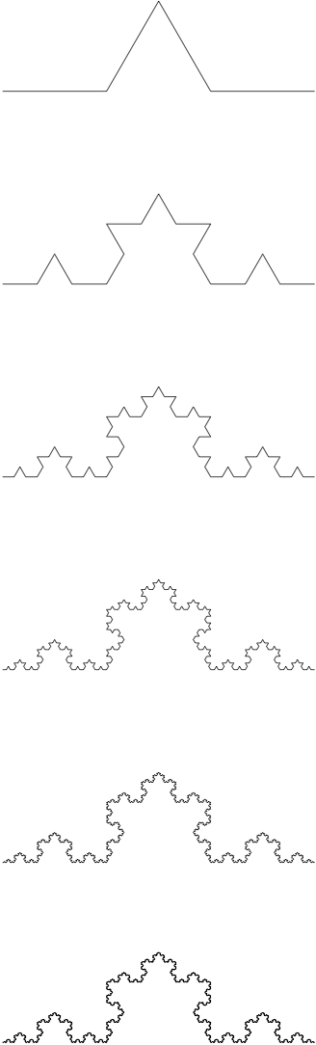
Why Use Recursion?
Complex problems can often be expressed simply and elegantly using recursion
Results in compact and clear algorithms
Is closely coupled to important data structures (e.g., trees)
Easier to prove the correctness of algorithms
/kochR { 2 copy ge {dup 0 rlineto} { 3 div 2 copy kochR 60 rotate 2 copy kochR -120 rotate 2 copy kochR 60 rotate 2 copy kochR } ifelse pop pop } def

Slide 16
There is No Magic
even(n) =
true if odd(n−1) is true
false otherwise
odd(n) =
true if even(n−1) is true
false otherwise
int puzzle(int n) {
if (n == 1)
return 1;
else if ((n % 2) == 0)
return puzzle(n/2);
else
return puzzle(3∗n + 1);
}
Not workable definitions of even and odd
The termination of puzzle for any n has not been proved

Slide 17
There is No Magic
Procedural programs can be turned into recursive programs
Recursive programs can be turned into procedural ones

Slide 18
Generality / Templates
We will present a number of problems
We will present specific (if high level) algorithms for them
However to adapt the idea you need a template
We will try to present a basic template of each idea after the example problem

Slide 19
Problems

Slide 20
Problem list
TSP
Minimum Spanning Tree
Sorting
Fibonacci numbers
Missionaries & Cannibals
A Maze

Slide 21
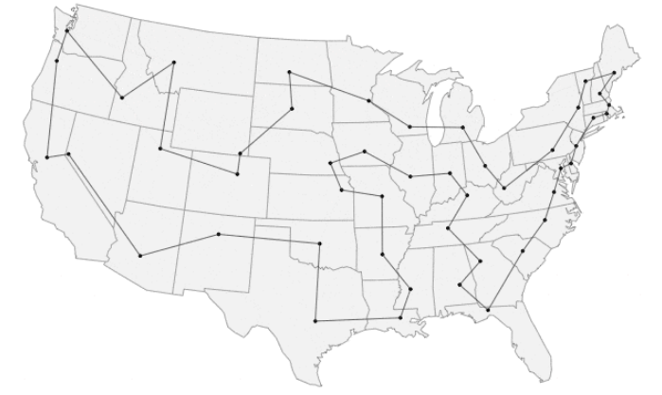
Travelling Salesman Problem (TSP)
TSP is the problem of a salesman who wants to find, starting from his home town, a shortest possible trip through a given set of customer cities and to return to its home town, visiting exactly once each city

Slide 22
TSP – BRUTE FORCE (n!)
Generate every possible solution to the TSP and keep the best
Best_solution = generate1
For sol in generate_all_solutions(tsp):
if sol <= best_solution:
best_solution=sol
Def generate_all_solutions(tsp):
root=[city1]
open_options=generate_branches(root)
while open_options:
x=open_options.pop()
if solution(x):
yield x
else:
open_options.add_on_front(generate_branches(x))

Slide 23
Minimum Spanning Trees
Example: Computers located at different physical locations are to be connected through a network.
How to build the network using as little cable as possible?
A
6
5
1
B
5
5
D
C
3
2
6
4
E
F
6

Slide 24
Two Greedy Solutions
Let U = {some node} and T = ∅
Find smallest <u, v> ∈ E such that u ∈ U and v ∈ V−U
Let T = T ∪ {<u, v>}
Let U = U ∪ {v}
Repeat from 2 until U = V
Let S = {{v₁}, .., {v_{n}}} and T = ∅
Select smallest <u, v> ∈ E
If u ∈ S_{u} and v ∈ S_{v}, where S_{u} ≠ S_{v}: Let T = T ∪ {<u, v>} Let E = E−{<u, v>} Replace S_{u} and S_{v} with S_{u} ∪ S_{v} in S
Repeat from 2 until E = ∅

Slide 25
Two Greedy Solutions
A
6
5
Let U = {some node} and T = ∅
Find smallest <u, v> ∈ E such that u ∈ U and v ∈ V−U
Let T = T ∪ {<u, v>}
Let U = U ∪ {v}
Repeat from 2 until U = V
1
B
5
5
D
C
3
2
6
4
E
F
6
T is the set of selected edges in the solution.
U is the set of connected nodes.
V is the set all nodes.
So V-U is the set of unconnected nodes

Slide 26
General Greedy Algorithm
Set greedy(Set cands) {
Set partial = ∅;
while (!solution(partial) && cands != ∅) {
Candidate c = bestCandidate(cands);
cands.remove(c);
partial.add(c);
if (!feasibleSolution(partial))
partial.remove(c);
} if (solution(partial)) return partial;
else return ∅; // No solution
}

Slide 27
Typical D&Q: Merge Sort
UNSORTEDSEQUENCE
UNSORTED SEQUENCE
UNSO RTED SEQU ENCE
UN SO RT ED SE QU EN CE
NU OS RT DE ES QU EN CE
NOSU DERT EQSU CEEN
DENORSTU CEEENQSU
CDEEEENNOQRSSTUU

Slide 28
Merge Sort
Def mergesort(inputlist):
if inputlist==[]: return []
elif inputlist of length 1:
return inputlist
else:
l1,l2=split(inputlist)
l1=mergesort(l1)
l2=mergesort(l2)
return merge(l1,l2)
Already sorted?
Divide the list into two equal parts
Sort each half recursively
Merge the sorted halves into a sorted whole

Slide 29
General D&Q Algorithm
divideAndConquer(Problem p) {
if (p is simple or small enough) { return simpleAlgorithm(p); } else {
divide p in smaller instances p₁, p₂, ..., p_{n}
Solution solutions[n];
for (int i = 0; i < n; i++) { solutions[i] = divideAndConquer(p_{i}); } return combine(solutions); }
}
Notes:
Three fundamental issues:
How to split the original problem?
How to solve the sub-instances?
How to combine the obtained sub-solutions?
The answers to the first and third questions depend on the nature of the problem
In most cases, the answer to the second question is: Using the same method:
When to stop decreasing the problem instance, i.e. what is the minimal instance of the given problem and how to solve it?
When we use recursion, the solution of the minimal instance is called “terminating condition” (or “base case”)

Slide 30
Dynamic Programming and the Principle of Optimality
In an optimal sequence of choices, actions or decisions of each sub-sequence must also be optimal:
Examples include finding the shortest path between two cities
An optimal solution to a problem is a combination of optimal solutions to some of its sub-problems
Not all optimization problems adhere to this principle
Dynamic programming is similar to D&Q:
Divides the original problem into smaller sub-problems
Many times it is hard to know beforehand which sub-problems that are needed to be solved in order to solve the original problem
Dynamic programming solves a large number of sub-problems and uses some of the sub-solutions to form a solution to the original problem
Is a bottom-up technique
Notes:
In contrast, D&Q is a top-down technique, which progresses from the initial problem instance down to the smallest sub-instance via intermediate sub-instances

Slide 31
Dynamic Programming
The same sub-problems may reappear
To avoid solving the same sub-problem more than once, sub-results are saved in a data structure that is updated dynamically
Sometimes the result structure (or parts of it) may be computed beforehand
long fib(int n) {
if (n < 2) return 1; else return fib(n−1) + fib(n−2);
}
fib(4) = fib(3) + fib(2)
.. fib(2) + fib(1) + fib(2)
.. fib(1) + fib(0) + fib(1)
+ fib(2)
.. fib(1) + fib(0) + fib(1)
+ fib(1) + fib(0)

Slide 32
Examples of Dynamic Programming
Table t = new Table();
int fib(int n) { if (n < 2) return 1; else { bool ok; int answer = t.retrieve(n, ok) if (!ok) { answer = fib(n−1) + fib(n−2); t.insert(n, answer); } return answer; } }

Slide 33
State Space Search (leading to backtracking)
Solving problems through the systematic search for solutions in a (large) state space
The general idea is to incrementally extend partial solutions until a complete solution is obtained
Example: Navigating a city
How do we know that we have arrived?
Movement as the transition from one location to another
?
?
G
?
?
S
How do we represent locations?
What guides us in the direction of our destination?
How to handle alternatives?

Slide 34
State Space Search (cont.)
Search is the systematic process of
Generating alternatives
choosing one alternative,
saving the rest in case our current idea does not lead to the goal
Can be thought of as the construction and traversal of search trees
Example: The 8-puzzle
How do we represent boards?
5
3
2
?
1
2
3
What is a solution?
8
4
8
4
1
7
6
7
6
5
A move as the transition from one board to another
5
3
2
How to handle alternatives?
8
4
1
7
6
What guides us in the direction of the solution?
5
3
2
5
2
5
3
2
5
3
2
8
4
8
3
4
8
4
8
7
4
1
7
6
1
7
6
1
7
6
1
6
Notes:
Resource allocation (making optimal decisions about how to commit assets like time, people etc.)
Medical applications (e.g., drug design)
Engineering design optimisation
Optimal control (e.g., traffic and robots)
Time-series forecasting (e.g., stock market data)
Data mining and knowledge discovery
…

Slide 35
State Space Search (cont.)
The initial state (e.g., an address or a board)
A set of operators which take us from one state to another state (e.g., walk or slide a tile)
A goal-test which decides when the goal is reached (e.g., comparing addresses or boards):
Explicit states (e.g., a specific address or board)
Abstractly described states (e.g., any post office)
A description of a solution (e.g., the address, the path between locations or the moves used):
The search path (e.g., the shortest path between your home and your office or the series of moves)
Just the final state (e.g., the post office)
A cost function (e.g., time, money, distance or number of moves) = true cost for going from start to where we are now + estimated cost for going from we are now to the nearest goal:
Search cost, the cost for concluding that a certain operator should be used (e.g., the time it takes to ask someone for directions or thinking about a move) +
Path cost, the cost for using a operator (e.g., the energy it takes to walk or time)
Notes:
Resource allocation (making optimal decisions about how to commit assets like time, people etc.)
Medical applications (e.g., drug design)
Engineering design optimisation
Optimal control (e.g., traffic and robots)
Time-series forecasting (e.g., stock market data)
Data mining and knowledge discovery
…

Slide 36
Example: Missionaries & Cannibals
Transport three missionaries and three cannibals from the left bank of a river to the right bank, using a canoe with room for two. The number of missionaries may never be less than the number of cannibals:
State: ⟨# M to the left, # C to the left, location of the canoe⟩
Start state: ⟨3, 3, l⟩
Goal state: ⟨0, 0, r⟩
Operators: move one of each, move one M, move one C, move two M or move two C
Cost: number of river crossings

Slide 37
State Space of M & C
⟨3,2,r⟩
⟨3,3,l⟩
⟨1,2,l⟩
⟨0,2,r⟩
⟨2,2,l⟩
Feasible states
⟨3,0,r⟩
⟨2,1,l⟩
⟨1,1,l⟩
⟨3,1,r⟩
⟨0,2,l⟩
⟨2,3,r⟩
Infeasible states
⟨3,2,v⟩
⟨3,1,l⟩
⟨0,0,l⟩
⟨0,3,l⟩
⟨0,1,r⟩
⟨1,1,r⟩
⟨2,2,r⟩
⟨3,3,r⟩
⟨0,0,r⟩

Slide 38
A Note on State Spaces
Propositional satisfiability problem (SAT):
Decide if there is an assignment to the variables of a propositional formula that satisfies it:
100 variables ⇒ 2¹⁰⁰ ≈ 10³⁰ combinations 1000 evaluations/second ⇒ 31,709,791,983,764,586,504 years required to evaluate all combinations!
Traveling salesman problem (TSP):
Given a number of cities along with the cost of travel between each pair of them, find the cheapest way of visiting all the cities exactly once and returning to the starting point
There are 2^{n} identical tours for each permutation of n cities ⇒ the number of tours are n!/(2n) = (n−1)!/2
A 50-city TSP therefore has about 3⋅10⁶² potential solutions

Slide 39
Search Trees
Node: A bookkeeping data structure: - State, parent, operator, cost, depth etc.
The frontier (fringe)
Already expanded nodes (CLOSED)
Nodes waiting to be expanded (OPEN)
Recently generated nodes waiting to be expanded (NODES)

Slide 40
Search Tree of M & C
⟨3,3,l⟩
⟨2,2,r⟩
⟨3,1,r⟩
⟨3,2,r⟩
⟨3,3,l⟩
⟨3,2,l⟩
⟨3,0,r⟩
⟨2,2,r⟩
⟨3,2,l⟩
⟨3,1,l⟩
⟨1,1,r⟩
⟨3,0,r⟩
⟨2,2,l⟩
⟨3,1,l⟩
⟨1,1,r⟩
⟨0,2,r⟩
⟨3,2,r⟩
⟨2,2,l⟩
⟨0,3,l⟩
⟨0,1,r⟩
⟨0,2,r⟩
⟨0,3,l⟩
⟨1,1,l⟩
⟨0,2,l⟩
⟨0,0,r⟩
⟨0,1,r⟩

Slide 41
General State Space Search Algorithm
Create a node S from the start state
Create a list, OPEN := [S], containing all nodes that have not yet been expanded
Create a set CLOSED := [], containing all nodes that have already been expanded
loop
if OPEN = [] then return failure
else
N := first element in OPEN
Remove N from OPEN
Add N to CLOSED
if N represents a goal state then return SOLUTION
else
NODES := the nodes we get by applying all applicable operators to N
Remove all nodes in NODES that are members of OPEN or CLOSED
OPEN := extend(OPEN, NODES)
Extend evaluates all open nodes according to how promising they are and may sort or truncate the resulting list of nodes

Slide 42
Backtracking
In each step, a promising alternative is chosen
If chosen alternative does not lead to a solution we backtrack to the most recent step with untried promising alternatives
If all alternatives of the first step have been tried without reaching a complete solution we have failed to find a solution
Backtracking is an instance of general state space search (or a realization of state space search):
Uses depth-first search, where NODES are just put in front of OPEN, i.e., the fringe is used as a stack, usually without a cost function
Notes:
Backtracking uses depth-first search, usually without a cost function
The main backtracking algorithm is as follows:
Push the initial state (the root of the search tree) onto a stack
While the stack is not empty do:
Pop a node from the stack
While there are available (untried) operators do:
Apply an operator to generate a child
If the child is a goal state – stop
If the child represents a new state, push the child onto the stack
The utility function is used to tell how close is a given state to the goal state and whether a given state may be considered a goal state
If no further children can be generated from a given node, then we backtrack – pop the next node from the stack

Slide 43
General Backtracking Algorithm
Solution backtrack(Solution partial) { if (solution(partial)) return partial; // Solution found! else { Solution next; while (extend(partial, next)) // Choose an alternative if (promising(next)) { // If promising: Solution s = backtrack(next); // expand recursively if (solution(s)) return s; // Solution found! } // Else, try next alternative } return partial; // Have tried all alternatives – backtrack! }
}

Slide 44
Navigating a Maze
Finding a way through a maze is a problem for which backtracking is suitable
If we reach a dead end, we backtrack to the most recent intersection and choose another path

Slide 45
Problem Representation – States
The maze is represented by a matrix
A state – description of a (partial) solution – consists of a maze and the current position
Maze of type 2d_array
State of type (Maze,position)
mazemap=
[ ##########,
#.#.#....#,
..#..##.##,
#.##.....#,
#..#.###.#,
##.#.#.#.#,
#..#...#.#,
#.##.###.#,
#.....#...,
##########]
Initial_state=(mazemap,
position(x=1,y=2))

Slide 46
Backtracking Function
def backtrack(partial): // partial is a state
if (solution(partial)):
return partial;
for next in extend(partial):
finalstate=backtrack(next)
if solution(finalstate):
return finalstate // recursion found a final state
return partial // the final deadend we hit

Slide 47
What is a complete solution?
def solution(s): return (s[1].x == 10) and (s[1].y == 8)
In other words, being at the exit location!!

Slide 48
How do we extend a solution?
Def extend(partial):
for (dx,dy) in [(1,0),(-1,0),(0,1),(0,-1)]: // could shuffle these too
newposition=position(x=partial[1].x+dx,y=partial[1].y+dy)
newmaze=copy_maze(partial)
place_wall(newmaze,partial[1]) // fill in the gap behind us in the copied maze
next=(newmaze,newposition)
if valid_location(next):
yield next
Basically, we generate moves in every direction.
Copy the map and fill in where we are moving from.
If the new partial is valid, send it back.
Note that this can return nothing at all!!!

Slide 49
What are promising solutions?
Closer to the exit?
Has possible future moves (not surrounded by walls)?
This is really a duplication of extend.

Slide 50
Conclusions
Usually, a given problem can be solved using various approaches, where some approaches result in much more efficient solutions and some approaches result in clearer, more easy to understand, algorithms
Greedy algorithms don’t regret anything:
Suitable when sub-optimal solutions are acceptable
A locally optimal solution can often be optimized globally afterwards
D&Q is suitable for (nearly) dividable problems, consisting of independent sub-problems:
The complexity is typically O(n⋅log n), but this is dependent on the branching factor (e.g., 2 in mergesort), the cost of dividing the problem (e.g., O(1) in mergesort) and the cost of combining sub-solutions (e.g., O(n) in mergesort)
Notes:
Usually a given problem can be solved using various approaches however it is not wise to settle for the first that comes to mind. More often than not, some approaches result in much more efficient solutions than others. Consider again the Fibonacci numbers computed recursively using the decrease-and-conquer approach, and computed by iterations using dynamic programming. In the first case the complexity is O(2^{n}), while in the second case the complexity is O(n). On the other hand, consider sorting based on decrease-and-conquer (insertion sort) and brute force sorting. For almost sorted files insertion sort will give almost linear complexity, while brute force sorting algorithms have quadratic complexity.
The basic question here is: How to choose the approach? First, by understanding the problem, and second, by knowing various problems and how they are solved using different approaches

Slide 51
Conclusions (cont.)
Dynamic programming can be regarded as a technique for improving efficiency:
Similar to D&Q, but without predefined criteria for dividing a problem into subproblems
In contrast to greedy algorithms, backtracking doesn’t discard untried alternatives, but keeps them for the future if the chosen alternative turns out not to lead to a solution:
A way of performing a systematic and exhaustive search of the state space for a solution
Notes:
Usually a given problem can be solved using various approaches however it is not wise to settle for the first that comes to mind. More often than not, some approaches result in much more efficient solutions than others. Consider again the Fibonacci numbers computed recursively using the decrease-and-conquer approach, and computed by iterations using dynamic programming. In the first case the complexity is O(2^{n}), while in the second case the complexity is O(n). On the other hand, consider sorting based on decrease-and-conquer (insertion sort) and brute force sorting. For almost sorted files insertion sort will give almost linear complexity, while brute force sorting algorithms have quadratic complexity.
The basic question here is: How to choose the approach? First, by understanding the problem, and second, by knowing various problems and how they are solved using different approaches

